Slide 1
GIP presentation
The pinball machine by Robin monsere

Slide 2
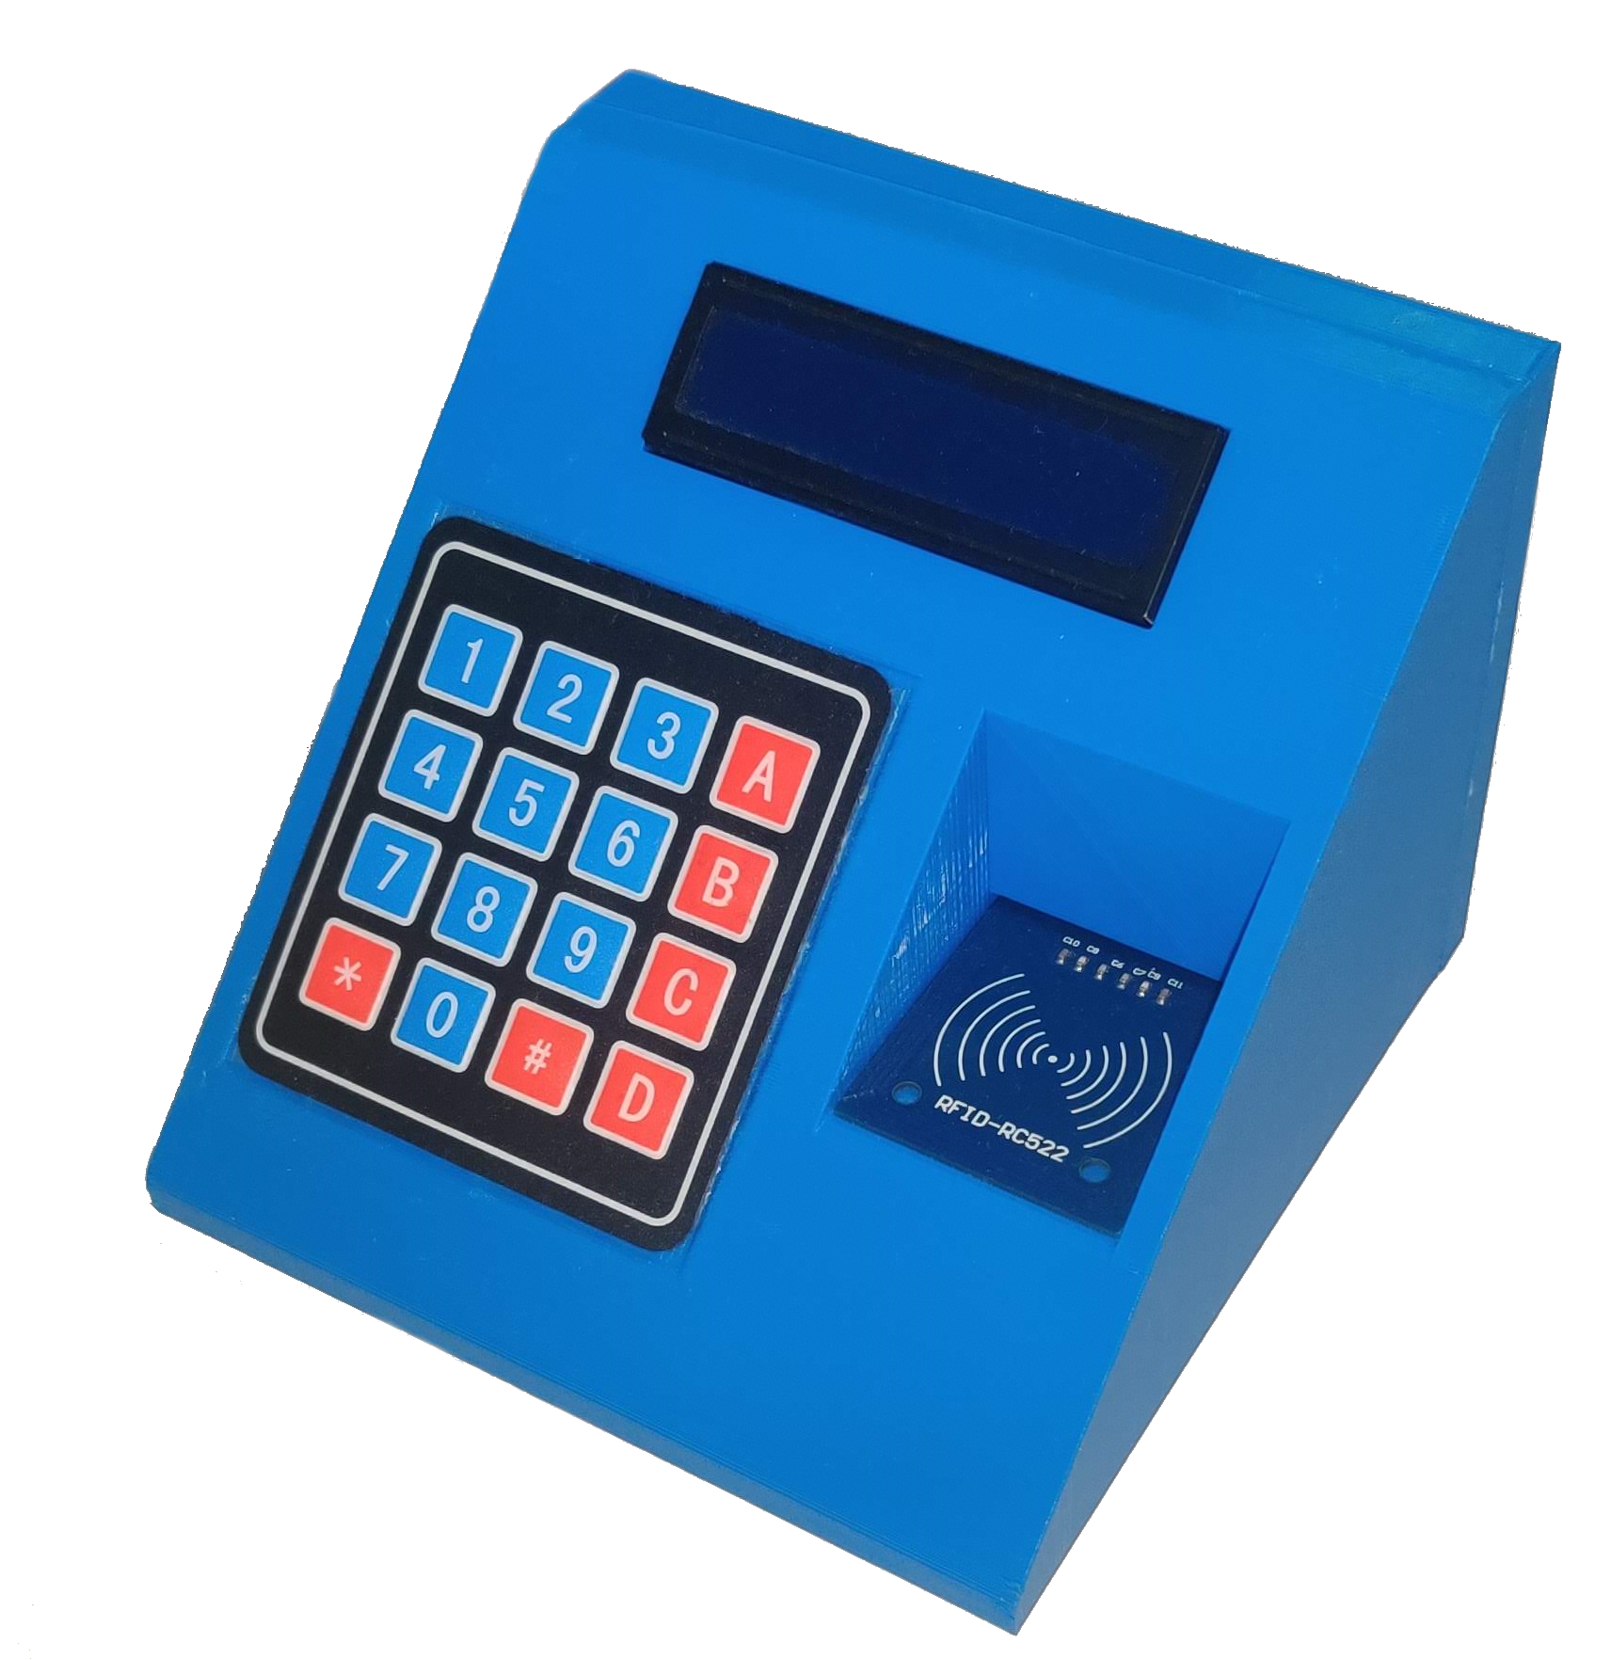
2 parts

Slide 3
No external partner/company
Had a lot of ideas
Has electronics/software/moving parts
Wanted to learn RFID

Slide 4
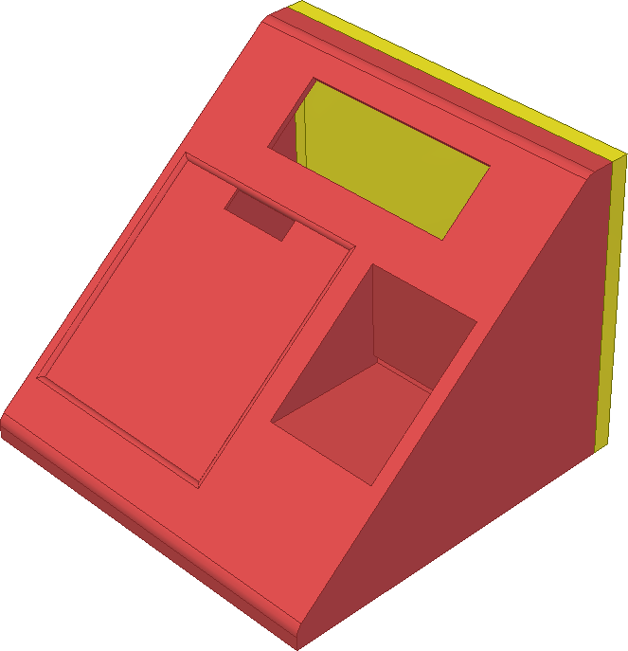
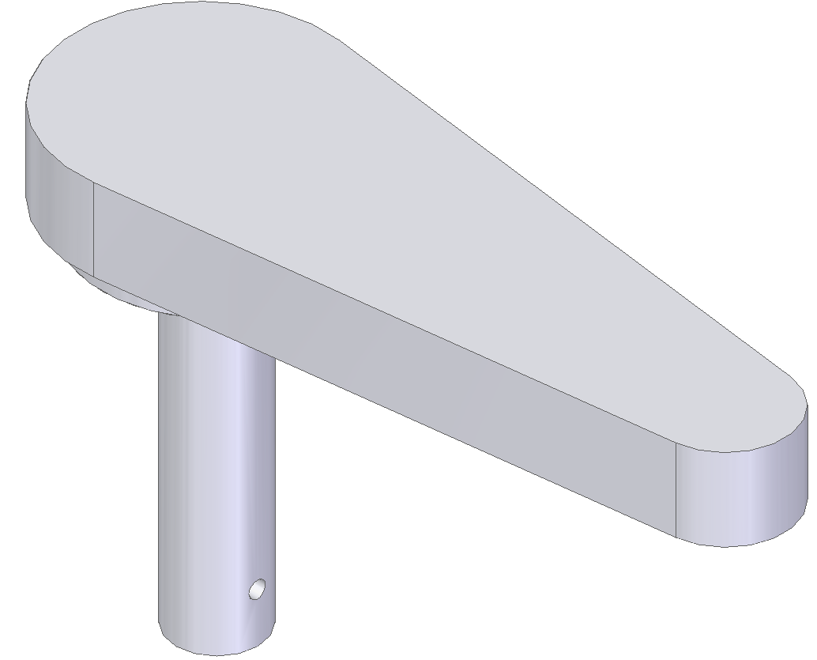
How? – 3D printing
Sketches
3D drawing
Printing

Slide 5
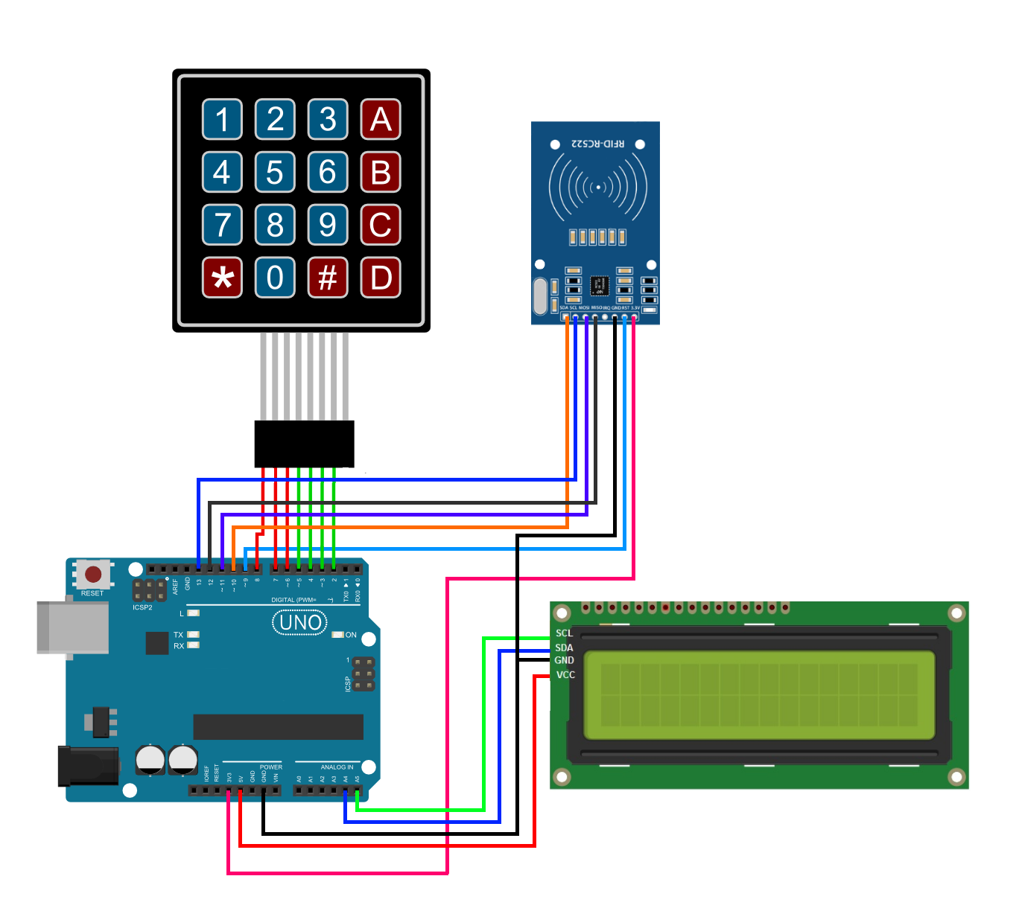
How? – Electronics
Sketches

